Slide 1
Op amps
A very basic introduction

Slide 2
Op amp “Golden Rules”
When an op amp is in its linear range then
The inputs are at the same voltage
The inputs draw no current

Slide 3
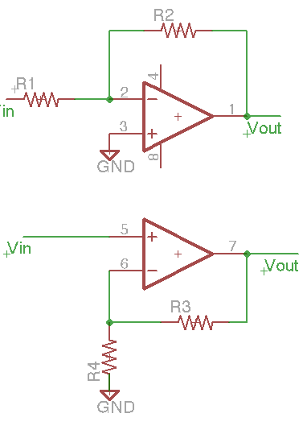
Inverting and non-inverting amplifiers
What are Z_{in} and gain?
  Answer with the Golden Rules
8
4

Slide 4
Inverting amp Z_{in} and gain
V₋ = 0 (Rule 1)
V_{in} / R₁ = (V₋-V_{out})/R₂ (Rule 2)
V_{in} / R₁ = -V_{out}/R₂
V_{out} = (-R₂/R₁)V_{in}
Gain = -R₂/R₁
Z_{in} = V_{in}/i_{in} = V_{in} /(V_{in1}/R₁) = R₁
Note: V₋ is called a “virtual ground”, because it is (actively) held at ground potential by the op amp, but isn’t directly connected to ground.

Slide 5
Non-inverting amp Z_{in} and gain
V₋ = V_{in} (Rule 1)
(Rule 2)
Substitute and cross multiply:
R₄V_{out}-R₄V_{in} = R₃V_{in}
R₄V_{out} = (R₃+R₄)V_{in}
Gain = (R₃+R₄)/R₄ = 1+R₃/R₄
Z_{in} = ∞ (Rule 2)

Slide 6
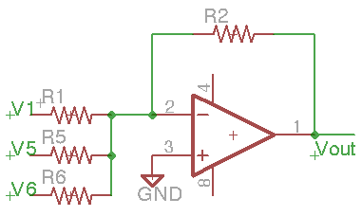
Embellishments
The inverting amp is a “mixer” or adder:
A voltage on V₊ adds to (offsets) V_{out}
The R’s can be generalized
to Z’s, and they can be any combination of devices, complex impedances, etc. E.g.,
  Capacitors and inductors will make the gain frequency dependent
  Diodes can make the gain polarity dependent
The amplifier will become nonlinear (output not proportional to input) without negative feedback at all relevant frequencies, including DC
Op amps saturate (and thus become nonlinear) when their inputs or output approach the power supply “rails”

Slide 7
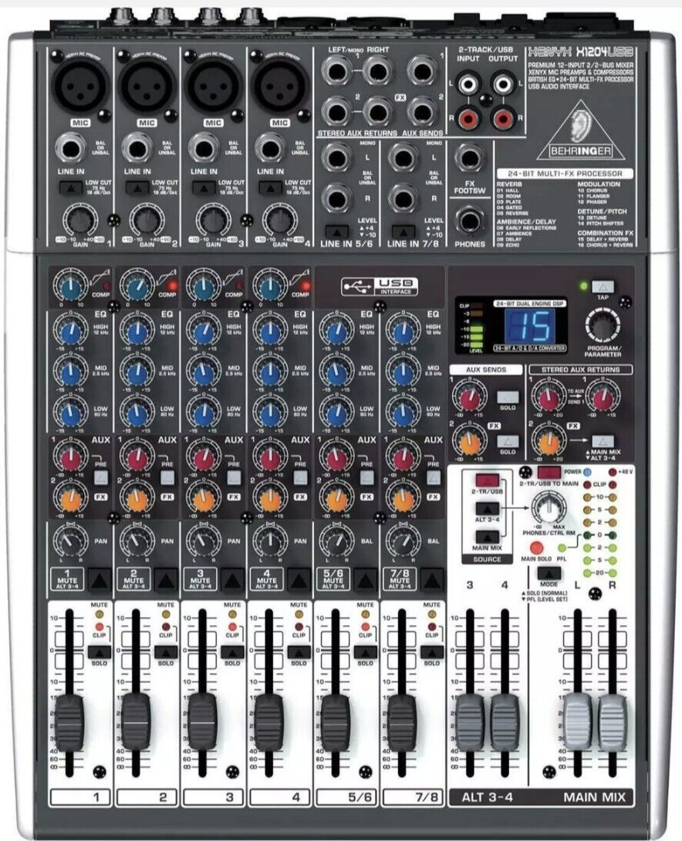
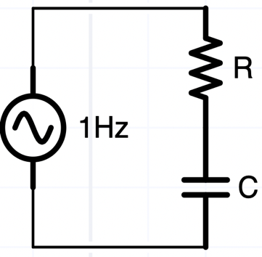
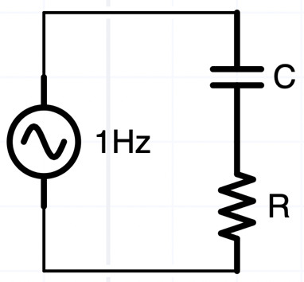
Low pass filter
High pass filter
Gain or Attenuation
Mixing, combining

Slide 8
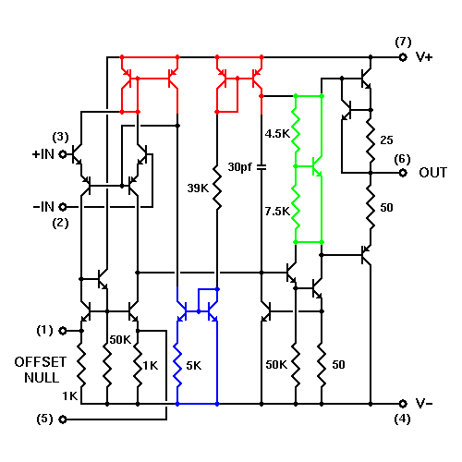
Interested in what’s under the hood?
What familiar abstractions do you see?

Slide 9
Or just follow the golden rules …
When an op amp is in its normal working range then
The inputs are at the same voltage
The inputs draw no current

Slide 10
Pease op-amp tech note

Slide 11
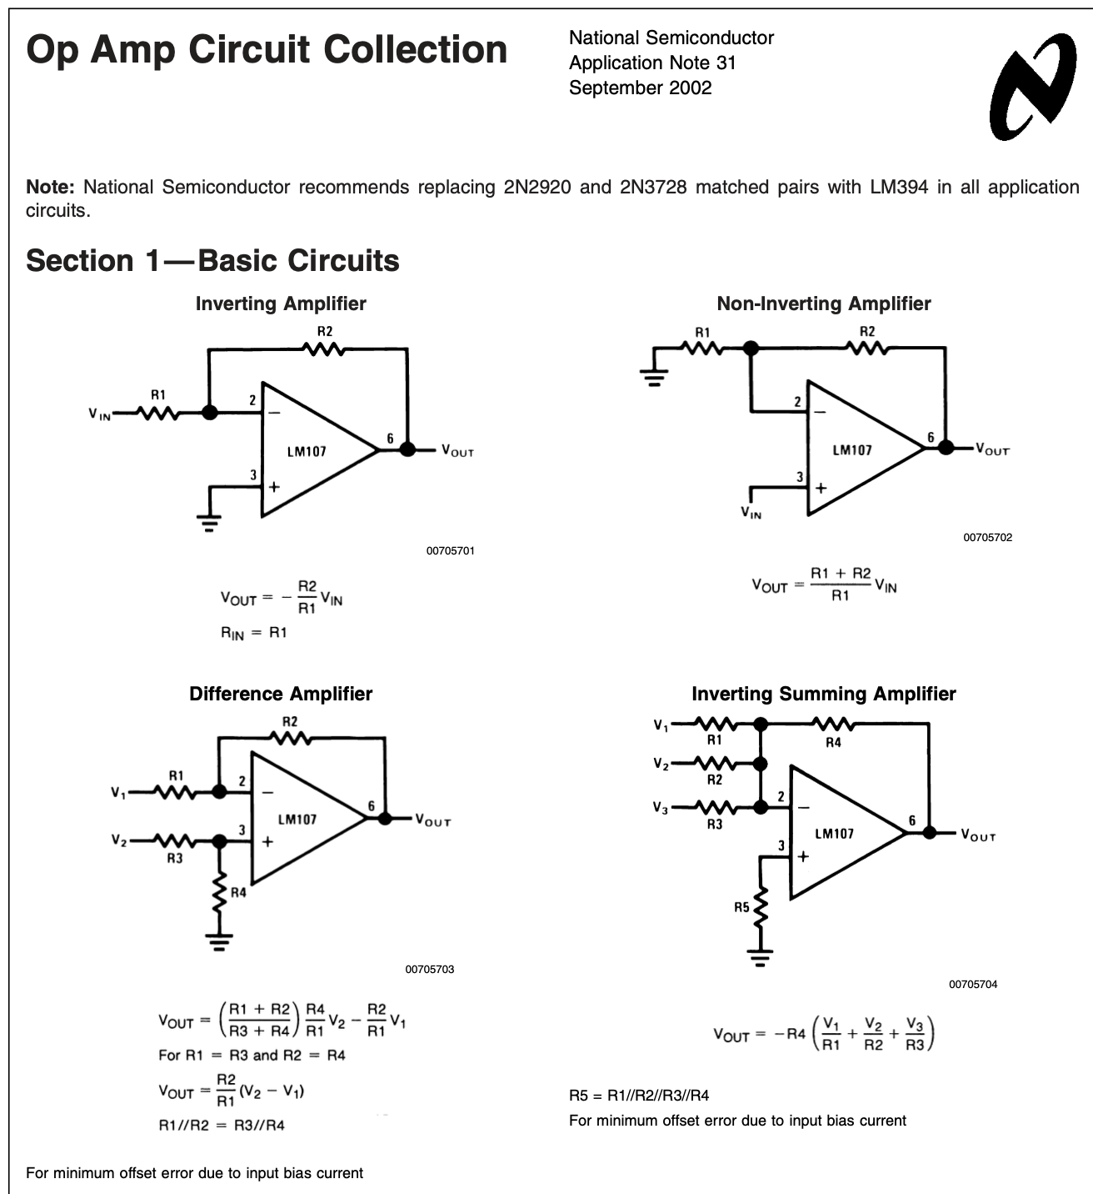
Difference amp CMMR = “common mode rejection ratio” depends on the accuracy of matching the resistors in the difference amp → much better performance if precision resistors are integrated into the IC

Slide 12
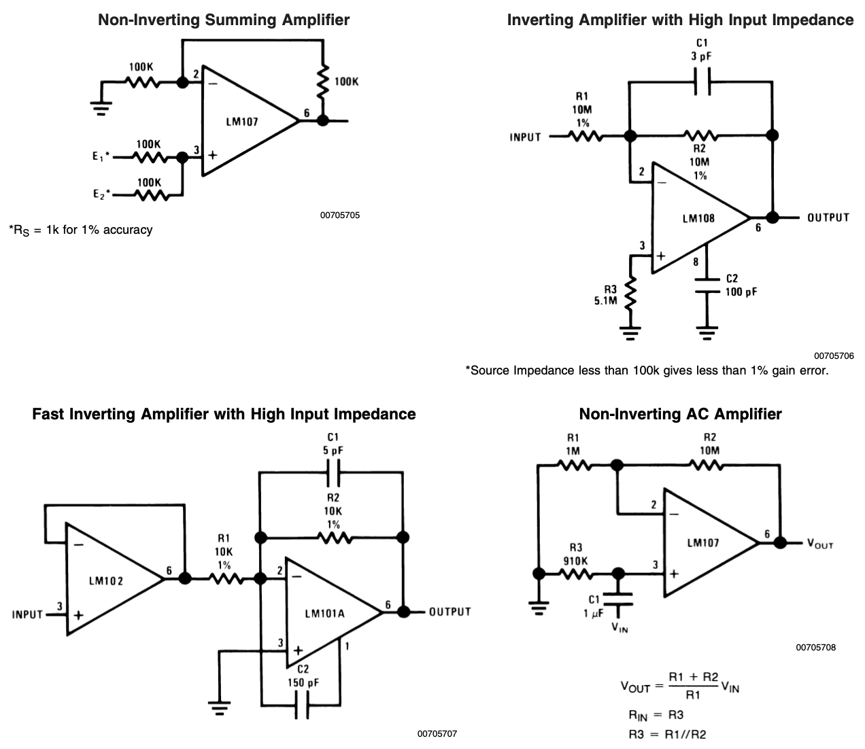
National Semiconductor AN31 cont’d
“Follower” is a powerful construct – the input Z can be super high (>10¹²Ω) with JFET op-amps

Slide 13
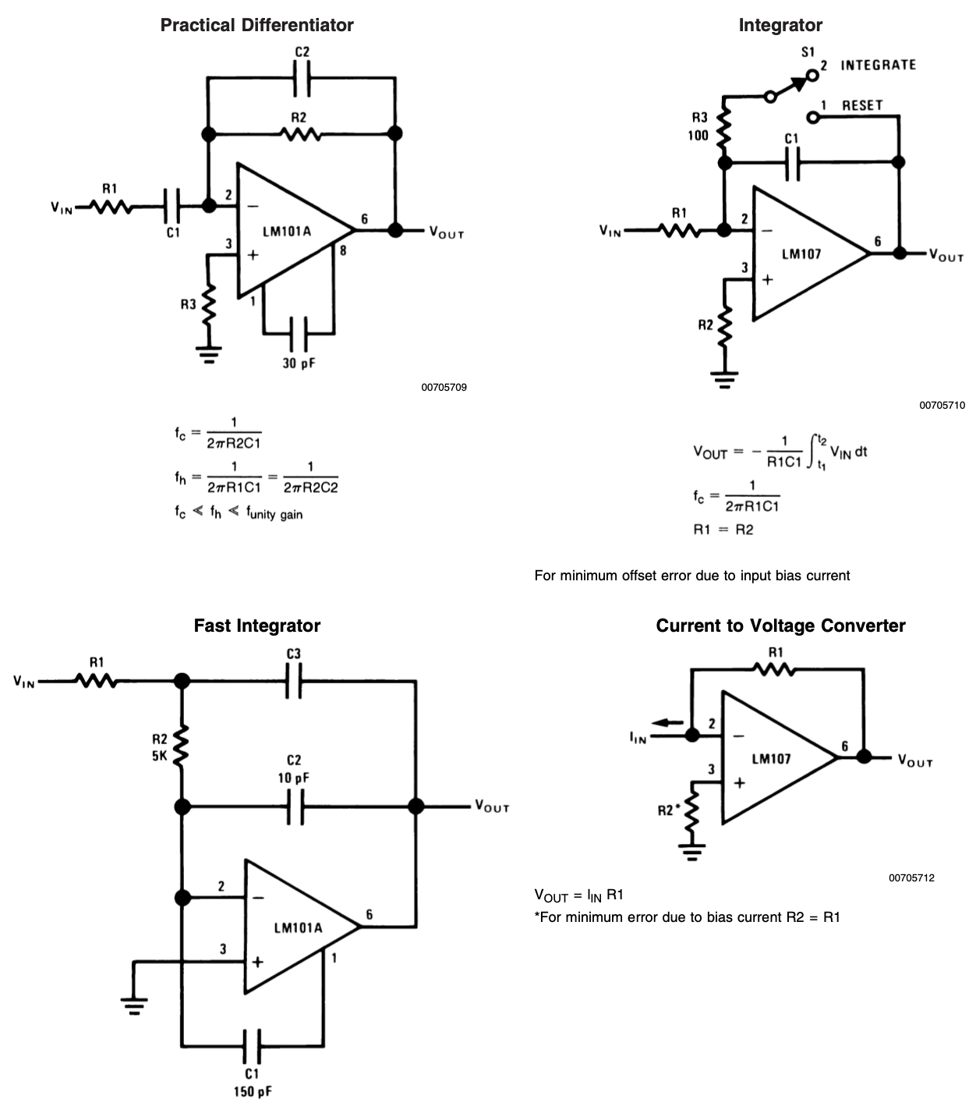
Calculus with op-amps

Slide 14
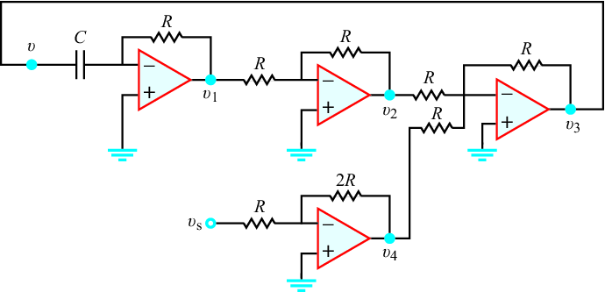
Op-amps solve differential equations
Show that this op-amp circuit with R=10kΩ and C=20μF solves the differential equation:
dυ/dt+5υ=10υ_{s}

Slide 15
Op-amps solve differential equations
Recognize each op-amp is inverting.
The voltage on the right side of C is … zero (a “virtual ground”)
The current through the capacitor i = Cdυ/dt must (all) go through the feedback resistor R
Thus υ₁ = 0-iR = -RCdυ/dt = -(1e4)(20e-6) dυ/dt = -0.2 dυ/dt
υ₂ = −υ₁ because the gain is –R/R = -1
υ₄ = −2υ_{s}
υ₃= −(υ₂+υ₄)= −(−υ₁−2υ_{s})= υ₁+2υ_{s}= −0.2 dυ/dt+2υ_{s}
Also, υ₃= υ. Hence,
υ= −0.2dυ/dt+2υ_{s}
or
dυ/dt+5υ=10υ_{s}
which is the differential equation in the problem statement. QED

Slide 16
Questions?

Slide 17
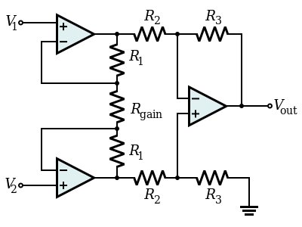
Instrumentation Amps
Op-amps are incredibly versatile, but one potential pitfall is they aren’t symmetrically differential
  The negative feedback (generally necessary for stable operation) reduces the negative input’s impedance
Instrumentation amplifiers (https://en.wikipedia.org/wiki/Instrumentation_amplifier) are designed to symmetrically differentially amplify voltages
Laser-trimmed resistors, at the same
temperature, … can achieve high
accuracy, e.g., the AD620 has a CMRR
of 100 dB with a differential gain
adjustable up to 1,000 using a single
external resistor

Slide 18
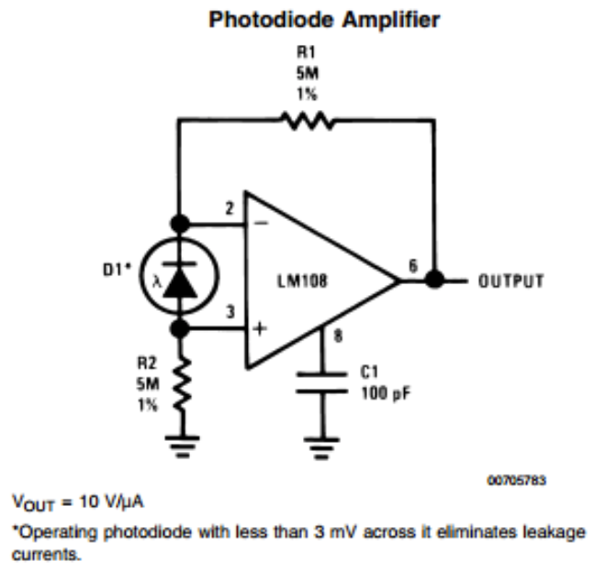
Photodiode amplifiers
Photodiodes produce small currents proportional to light
  If they’re small (lower capacitance), they can respond very quickly and have low noise
FET amps can work with R’s
of 100MΩ or more … but
have to handle those R’s
with great care …

Slide 19
Interfacing to transducers
Whether photodiodes or any other transducer that converts one form of energy to another, we approach the challenge of measuring the signal like any electronics problem
  Thevenin equivalent (or if necessary, a more complex device model or characteristic curve)
  Amplification to increase signal-to-noise ratio (SNR) – try to increase signal without proportionally increasing noise
  Filtering to preferentially attenuate noise while passing the signal
  …
  But we’re getting a little ahead of ourselves

Slide 20
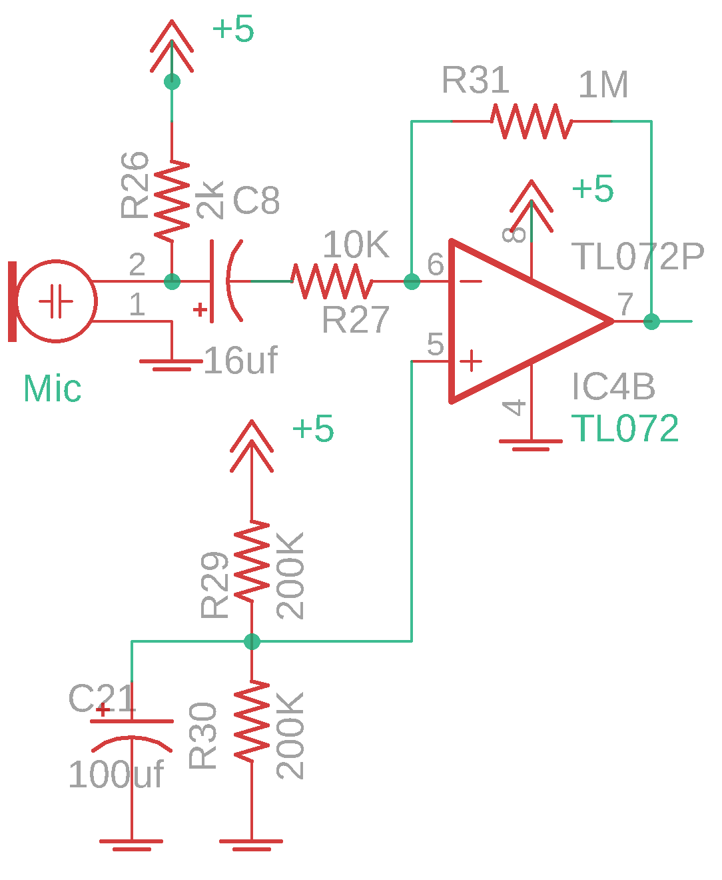
Microphones
Electret and MEMs microphones convert sound to voltage
  Data sheets or google “electret microphone circuit” for ideas
  High intrinsic impedances requires built-in FET
  R29 and R30 voltage divider makes a 2.5VDC bias for
  the op amp (pin 5 and 6), stabilized by C21
  (none of these values are critical, as long as R29~R30)
  R26 = 2k to match impedance of the mic (from datasheet)
  C8 couples AC output of the mic to the op-amp
  while blocking the mic’s DC bias voltage
    C8 and R27 are a high pass filter – why? Because the
    right side of R27 is “virtually” grounded (redrawn below)
    fc = 1/(2*pi*16e-6F*10e3Ω) = 1Hz, so f<1Hz are attenuated
  Gain = R31/R27 = 100
  Values of R29 = R30 don’t matter, they’re a voltage
  divider to make +5/2V.

Slide 21
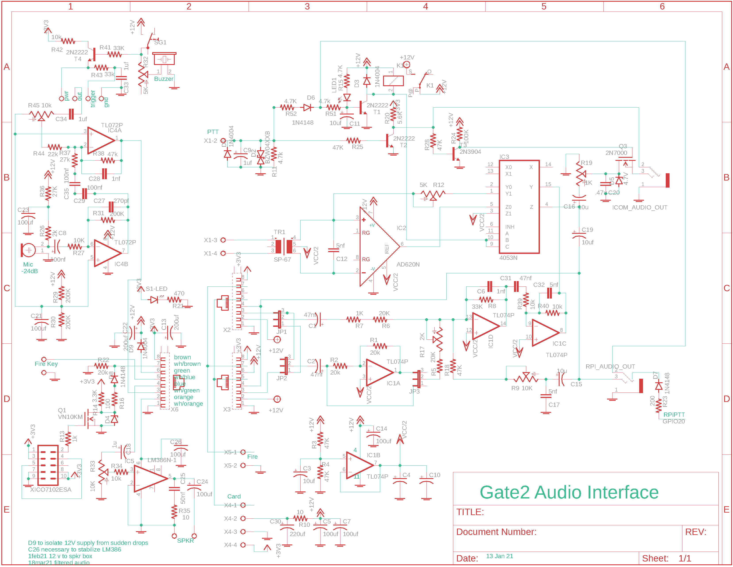
Higher performance audio
I use these mics on an intercom system
https://www.puiaudio.com/media/SpecSheet/AOM-5024L-HD-R.pdf
  “wants” 3V@500uA, and I have 12V → R36+R26 voltage divider,
  R26 = 2k to match impedance of the mic (from datasheet)
  R36 from 3V = 12V*R26/(R26+R36)
  C23 stabilizes the divided 3V, fc = 1/(2*pi*100e-6*2e3)<~1Hz
  C8 couples the AC output of the mic to the op-amp while
  blocking the mic’s DC bias voltage

Slide 22
Higher performance audio
Mic’s AC signal through C8 goes to IC4B through R27
Inverting amplifier configuration, DC bias set by
R29 and R30, stabilized by C21, at 6VDC
Gain = 200kΩ/10kΩ = 20 (ignoring C27 and C8)
C8 and R27 make a high-pass filter with corner
fc = 1/(2*pi*100e-9*10e3) = 160 Hz. At f < fc,
|Z_{C8}|> 10kΩ and G = 200kΩ/(|Z_{C8}+10kΩ|) is
less than 20
C27 and R31 make a low-pass filter with
fc = 1/(2*pi*270e-12*200e3) = 3kHz
For f>fc, |Z_{C27}|< 200kΩ so G < 20

Slide 23
Microphones
IC4B-7’s output goes through C29, C35, and R37 to
another inverting op-amp stage
DC gain = -R38/R37 (added to -R38/R44 times the
voltage from the top)
C29, C35, and R37 make a high-pass filter with
fc = 1/(2*pi*50e-9*27e3) = 120 Hz.
C28 and R38 make a low-pass filter with
fc = 1/(2*pi*1e-9*47e3) = 3.4kHz
As we saw with the PWM filter, each stage in
series makes the filter cut-off steeper. I designed
these filters to pass the major frequencies in
voice, while attenuating motors and other signals

Slide 24
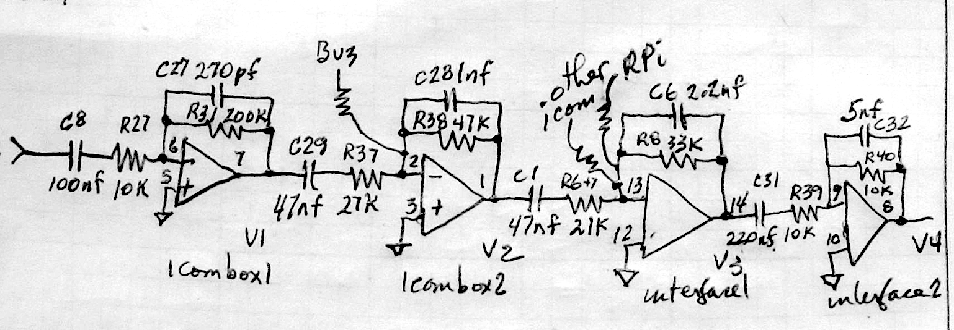
Intercom system
These 4 stages each implemented a low pass and high pass filter, along with mixing 3 other inputs

Slide 25
Simulating the Intercom
Two helper (1-line) functions, zp and zc:
function zparallel = zp(z1, z2)
% function zparallel = zp(z1, z2)
% returns z1 .* z2 ./ (z1 + z2), the parallel impedance
% 17 mar 21 BR
zparallel = z1 .* z2 ./ (z1 + z2);
end
function [zc] = zc(farads, hz)
% function zc = zc(farads, hz)
% compute complex impedances of capacitor with farads at frequencies hz
% hz can be a vector or matrix, and is persistent
% 7 apr 21 BR
persistent hzz
if nargin == 2, hzz = hz; end
j = sqrt(-1);
zc = 1 ./ (j*2*pi*farads*hzz);
end

Slide 26
Simulating the Intercom
ff = logspace(1,4,200)';% frequencies
% first stage of microphone amp
r31 = 200e3; c27=270e-12;
r27=10e3; c8 = 100e-9;
gain1 = zp(r31, zc(c27,ff)) ./ (r27+zc(c8,ff)); % = zfeedback/zinput
% 2nd stage of microphone amp
c29=50e-9; r37=27e3;
r38=47e3; c28 = 1e-9;
gain2 = zp(r38,zc(c28)) ./ (r37+zc(c29));
% summation stage of interface
r6=21e3; c1 = 50e-9;
r8=33e3; c6 = 1.5e-9;
gain3 = zp(r8, zc(c6)) ./ (r6 + zc(c1));
% filter stage
r39 = 10e3; c31 = 220e-9;
r40 = 10e3; c32 = 5e-9;
gain4 = zp(r40, zc(c32)) ./ (r39+zc(c31));
vout = gain1 .* gain2 .* gain3 .* gain4;

Slide 27
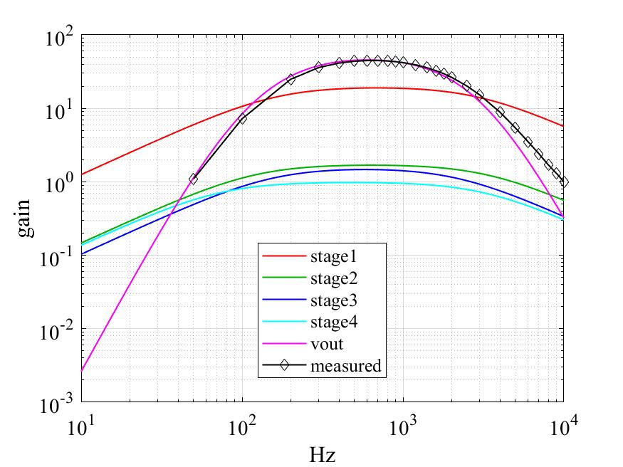
Simulating the Intercom
loglog(ff, abs([gain1 gain2 gain3 gain4 vout]))
grid; xlabel('Hz'); ylabel('gain');
legend('stage1','stage2','stage3','stage4','vout', ...
'location','best');
hold on;
vin = 10; % mVrms measured at mic input
freq = [50 100:100:1000 1200:200:2000]';
von14rms = [21 69 160 200 227 236 239 241 239 236 232 222 210 197 184 170]';
freq2 = [2500 3000:1000:10000]';
von14rms = [11 72 248 360 413 438 447 447 441 432 420 391 359 326 295 265 ]';
von142 = [201 152 89 54 35 24 17 13 10]';
loglog([freq; freq2], [von14rms; von142]/vin,'d-k')
legend('stage1','stage2','stage3','stage4','vout', 'measured','location','best');
Measurements with a function generator and AC voltmeter suggest one of the low pass filters wasn’t “working”

Slide 28
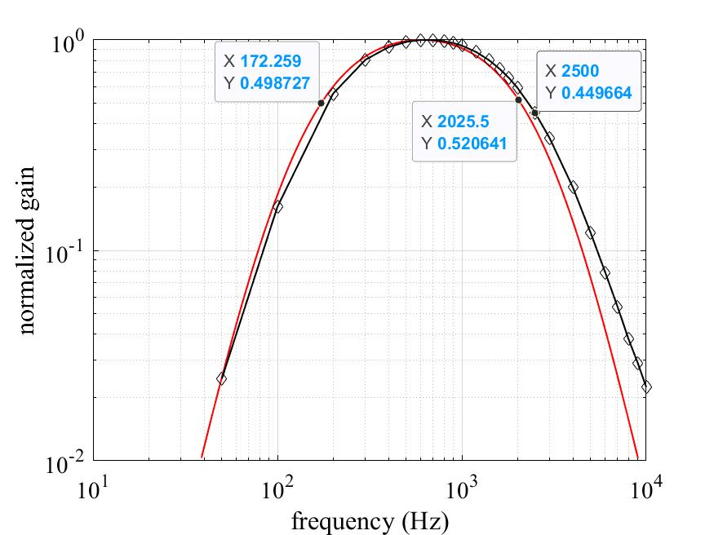
Measuring the Intercom
normGain = abs(vout)/max(abs(vout));
k = normGain>.01;
loglog(ff(k), normGain(k))
grid
xlabel('frequency (Hz)'); ylabel('normalized gain');
hold on
loglog([freq; freq2], [von14rms; von142]/max([von14rms; von142]),'d-k')
print -djpeg intercomFilter3db.jpg
50% attenuation at 172Hz & 2-2.3kHz
99% attenuation at ~40Hz and ~20kHz
This results in reduced hiss & airplane noise, better hearing of voices over truck engines, footsteps over birds, …
How to make the intercom more sensitive to detecting someone walking?
  I put coarse gravel on the (dirt road) driveway – the rocks make a lot of grinding noise when driven/walked on.

